Slide 1


Machine-learning address identifier
A machine-learning based approach on extracting address information from an unstructured text field.

Slide 2



MOTIVATION AND SCOPE
In modern data science, the analysis of free text fields is a major challenge. The text is often known to contain useful information (such as an address), but it can be difficult to reliably extract the information. Machine learning can teach an algorithm to recognize and select addresses from a free text field.
The business requirements for this project are to present a system that can reliably extract addresses from texts and present the same document with the extracted information anonymised. This is mainly for General Data Protection Regulation (GDPR) and for auditing purposes.
The exercise of this thesis is to demonstrate the following statement:
A word n-gram model combined with a machine-learning approach, in this case Naïve-Bayes, can be used to efficiently extract addresses from a free text field.

Slide 3
METHODOLOGY
The system reads the text from a document, extracts the addresses contained within it and transforms the input to render the document without any address data.
The program then pre-processes the documents into tokens and outputs them sequentially, each token will be labelled as one of the following four classes: BEGIN, INSIDE, END, and OTHER, which can be used to evaluate system performance or integrated with other systems.
These four classes will identify each token, determining if a token is in address block as the first, middle or last token or else if it is outside the address boundaries, using a n-Gram word model and a Naïve-Bayes classifier to determine the classes.

Slide 4
What is an n-gram?
An n-gram is defined as a tokens sequence. These tokens are usually words, though they can be characters or subsets of characters. The n defines the number of tokens.
The Word “n-gram model” is used to represent the surrounding context of a token to be classified. An N-gram model predicts the occurrence of a word based on the occurrence of its N – 1 previous words.
Example: My house is in 221b Baker St, London.
Word n-gram output(n=2)
My house ⇒ {attribute, attribute, ..., attribute} ⇒ OTHER
My house is ⇒ {attribute, attribute, ..., attribute} ⇒ OTHER
house is in ⇒ {attribute, attribute, ..., attribute} ⇒ OTHER
is in 221b ⇒ {attribute, attribute, ..., attribute} ⇒ OTHER
in 221b Baker ⇒ {attribute, attribute, ..., attribute} ⇒ BEGIN
221b Baker St ⇒ {attribute, attribute, ..., attribute} ⇒ INSIDE
Baker St, London ⇒ {attribute, attribute, ..., attribute} ⇒ INSIDE
St, London ⇒ {attribute, attribute, ..., attribute} ⇒ END

Slide 5

What are the features?
Feature | Description | Example
﻿all-ascii | If a word is using the standard ASCII characters | ASCII
﻿next-lemma | Next word lemma | ‘Go’ is the lemma for ‘goes’, ’going’, etc.
﻿﻿prev-lemma | Previous lemma | ‘Go’ is the lemma for ‘goes’, ’going’, etc.
﻿contains-dash | If it contains a dash | -
﻿contains-dot | If it contains a dot | .
﻿Lemma | word lemma | ‘Go’ is the lemma for ‘goes’, ’going’, etc.
﻿is-allcaps | If it is all capital letters | DUBLIN
﻿prev-all-caps | Previous word if it is all capital letters | DUBLIN
﻿next-all-caps | Next word if it is all capital letters | DUBLIN
﻿prev-prev-word | Token position -2 word | Street, road
﻿prev-prev-pos | Token position -2 pos | Noun, verb, etc.
﻿next-next-word | Token position +2 word | Street, road
﻿nextnextpos | Token position +2 Part of speech tagger | Noun, verb, etc.
Features are used to identify the characteristics of a specific word.
Commonly used to extract entities such as addresses in texts.
The table represent an extract of the features used for the models.

Slide 6
DATABASE COLLECTION
Tagger: (‘…the address is: Hillview, Whiterock South,Wexford.’) | Value (Part-of-Speech tag) Penn Treebank
(('the', 'DT'), 'O') | DT determiner
(('address', 'NN'), 'O') | NN Noun
(('is', 'VBP'), 'O') | VBP Verb Present
((':', ':'), 'O')
(('Hillview', 'NNP'), 'B') | NNP Proper Noun
((',', ','), 'I')
(('Whiterock', 'NNP'), 'I') | NNP Proper Noun
(('South', 'NNP'), 'I’) | NNP Proper Noun
((',’, ,'), ‘I')
(('Wexford', 'NNP'), ‘E') | NNP Proper Noun
A dataset containing 10403 IOB tagged sentences was used for this research, this dataset is a collection of different US and Irish addresses in different sentences.
Each word has a part-of-speech tag that identify its lexical and morphological identity.

Slide 7
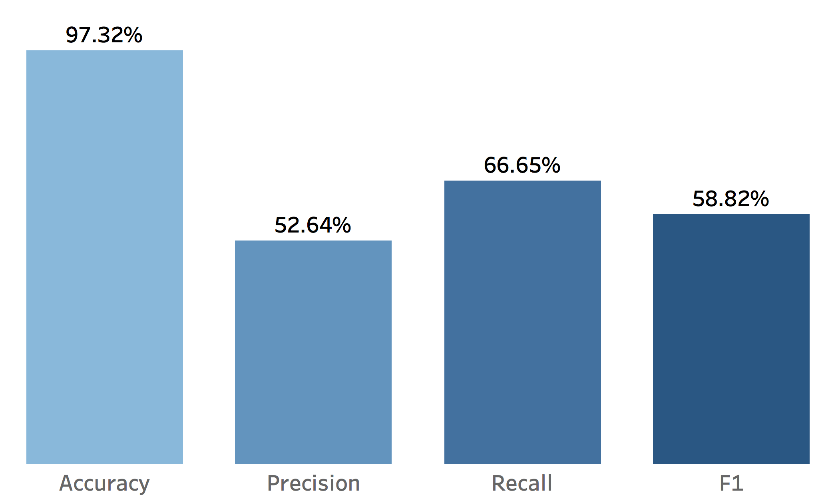
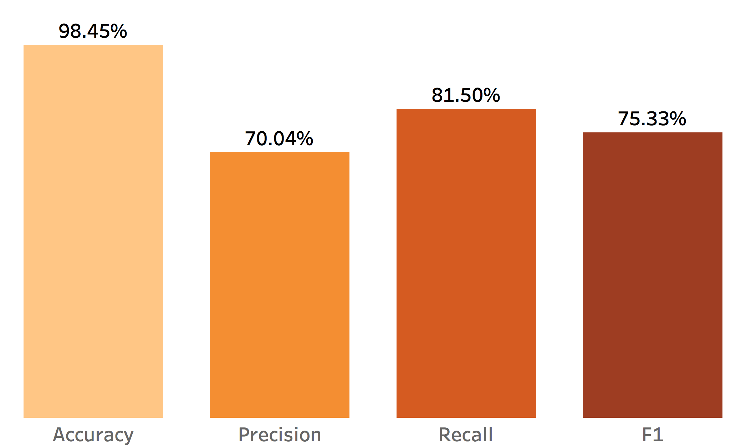
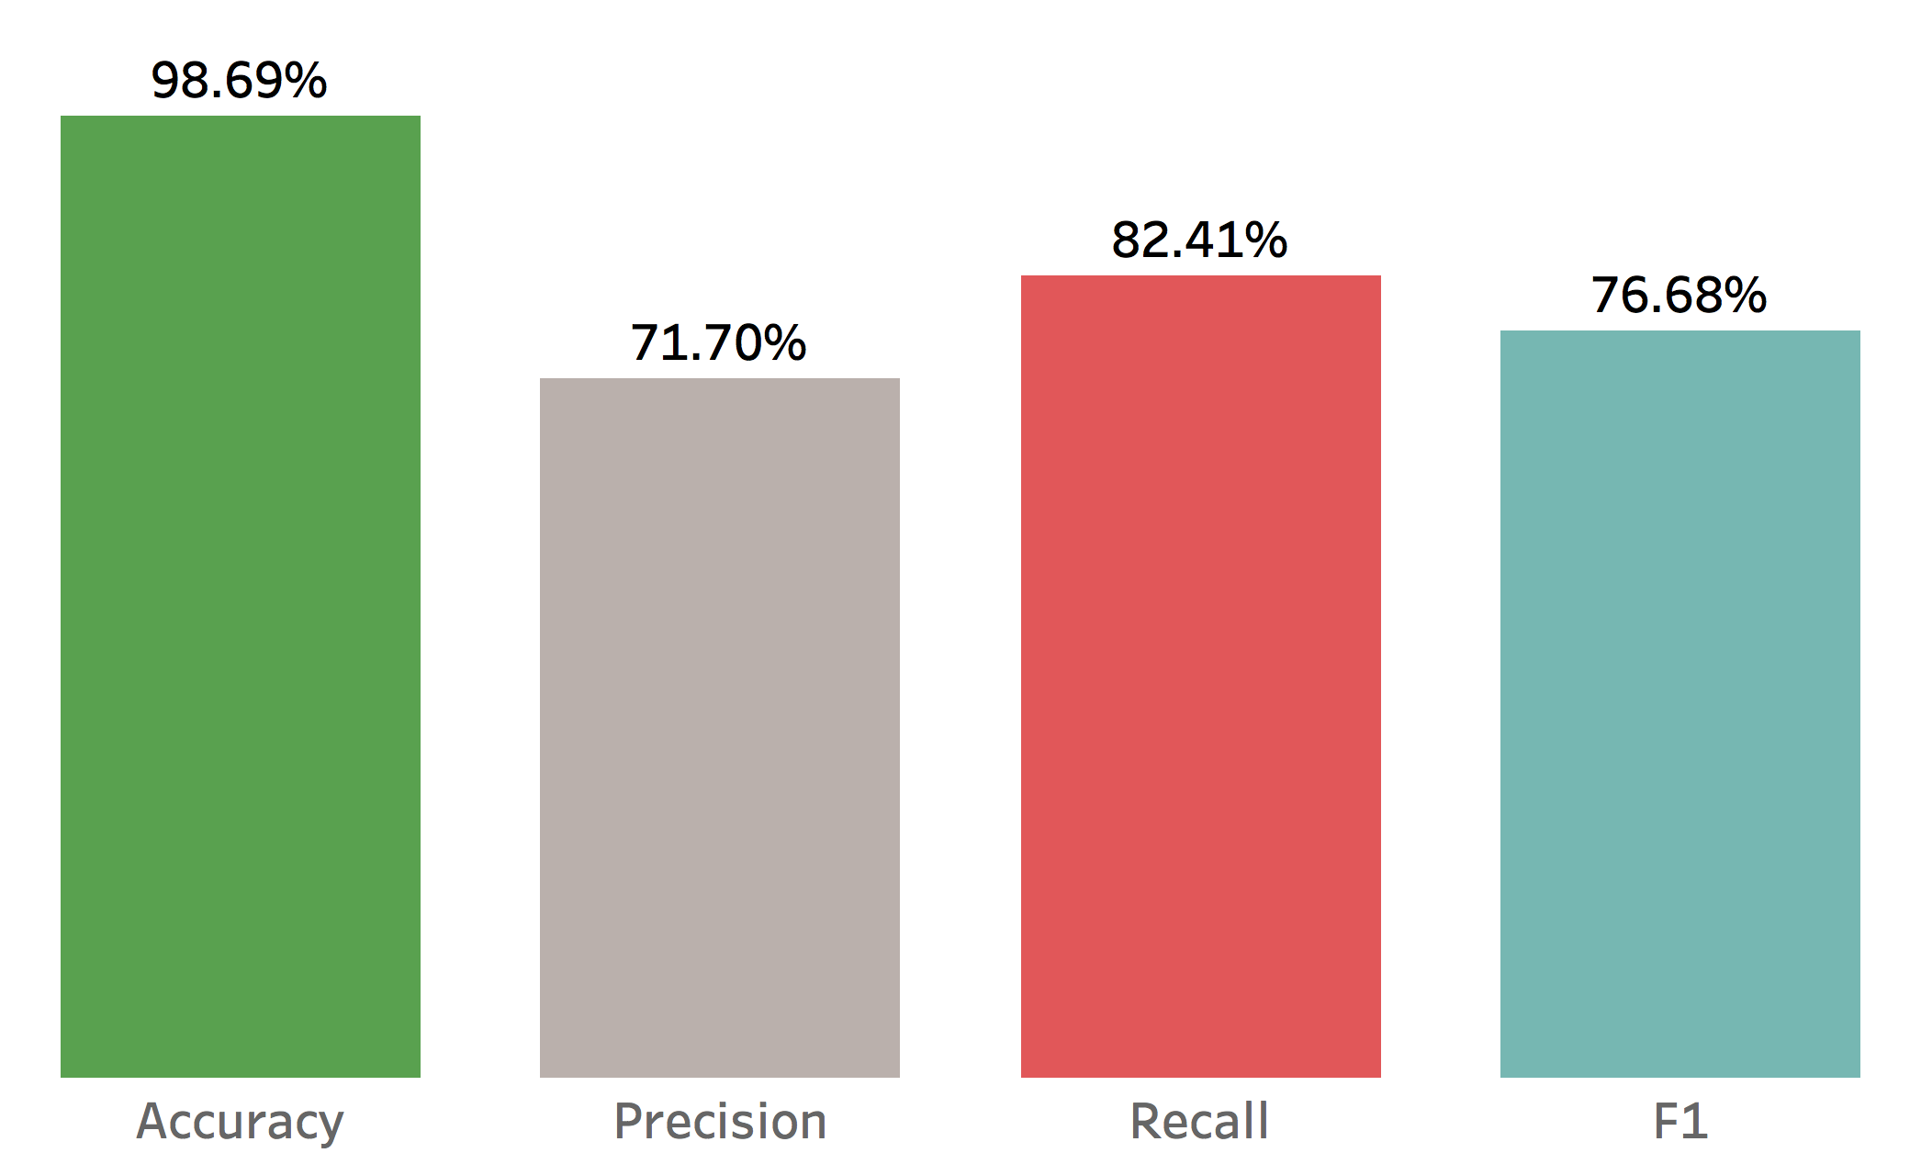
RESULTS
PRIS’s results after cross validation
Two models were created, one using a Bigram and a basic set of features (PRIS), another uses a Trigram, a stemmer and few more features (ROY).
When compared to a regular expression method, this approach has achieved higher evaluation results, without using any a priori set rule.
A focus was put on the recall rate measure, due to its importance when identifying and anonymizing addresses.
ROY’s results after cross validation
ROY’s results against the test set

Slide 8



EXAMPLES
Something that the model got right:
input: ‘﻿My name is Gabriele Frattaroli. I live in The Grove, Compass Hill, Kinsale, Co.Cork. My job involves Data Analysis.’
output: My name is Gabriele Frattaroli. I live in ### ######### ############ ###. My job involves Data Analysis.
Something that the model did not get:
input: “My name is Gabriele Frattaroli. I live in 2-98 Lon Hed-
-ydd, Llanfairpwllgwyngyll, LL61 5JY, UK. My job involves Data Analysis.
output: My name is Gabriele Frattaroli. I live in ### ### Hed-
-ydd, Llanfairpwllgwyngyll, LL61 5JY, UK. My job involves Data Analysis.

Slide 9

CONCLUSIONS
This machine-learning algorithm based on a Naïve-Bayes classifier and a n-gram model has been shown to deliver reliable results and has a collection of features that can be considered useful:
The system produces very accurate results without any dictionary.
Any amount of data, if properly formatted, can be added to the original dataset.
New features can be added and be customized according to the user specification.
This algorithm can also be added into existing information extraction systems.

Slide 10



Q&A

